Slide 1



Slide 2



 | Slope Bins 4 | Smear Count 25
Block number | Alpha w/ Henderson Hasselbalch | Chi Chi_max = 2.2
[0 50] | 0.040012 | 1.160000
[50 75] | -0.278451 | 0.720000
[75 125] | -0.519707 | 0.608000
[125 156] | -0.154453 | 0.529032

Slide 3


 | Slope Bins 4 | Smear Count 31
Block number | Alpha w/ Henderson Hasselbalch | Chi Chi_max = 2.2
[0 31] | 0.001103 | 0.922581
[31 62] | -0.386873 | 0.703226
[62 93] | -0.290146 | 0.967742
[93 496] | 0.037164 | 1.098759
[496 527] | -0.064533 | 0.819355
[527 620] | 0.010682 | 0.756989
[620 647] | -0.103326 | 0.696296

Slide 4
Binary results

Slide 5







For i as L and H:
Pure height profiles
Mixed height profiles
Current L library
Current H library
Skip; marginal increase in vol prob not enough
Move onto chi3.0; larger NFL vol library

Slide 6





NFL
All plotting wrong L pure; look only at purp
NFH
H volume too low to neutralize L (v = 31 nm3/c)

Slide 7







H volume v = 60 nm3/c

Slide 8







H volume too low to neutralize L

Slide 9








NFH, V = 70

Slide 10





NFH & NFL v = 0.15

Slide 11





Based on NFH b5v15c3, apply VL = VH
NFL and NFH are from same amino acids but diff chain lengths. Should VL = VH?
L30 / H70
L80 / H20
L30 / H70
L80 / H20

Slide 12
L/H Fitting

Slide 13


VL = VH

Slide 14






Try b change, v same as H (0.15)
Phi unrealistic (?)
Phi unrealistic
Phi very unrealistic
Phi very unrealistic

Slide 15






Try similar params to H
5.6
11.2
16.8
28
56
7.5
11.25
18.75

Slide 16


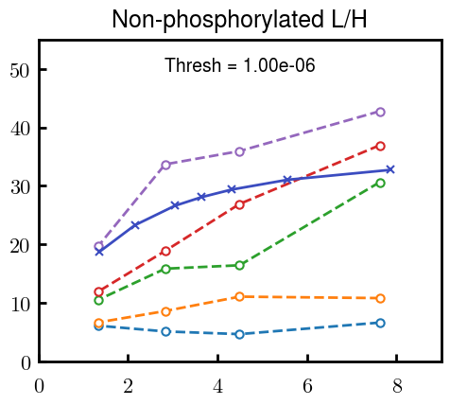
Try similar params to H, b change
7.8
15.6
23.4
31.2
Unrealistic vol

Slide 17


Continuation from prev params

Slide 18







v2.7 and some fine
b1.50 v2.7 c3.2
b1.75 v2.7 c3.2
b1.75 v2.5 c3.2
b1.75 v2.5 c3.0
b2.0 v2.7 c3.2
b2.25 v2.7 c3.2
b2.50 v2.7 c3.2
Phi too small to decrease v0

Slide 19










b2.0 v10.0 c3.0
b2.0 v8.0 c3.0
b2.0 v6.0 c3.0
b2.0 v4.0 c3.0
b2.0 v2.0 c3.0
Phi limit
b1.8 v10.0 c3.0
b1.8 v8.0 c3.0
b1.8 v6.0 c3.0
b1.8 v3.0 c3.0
b1.8 v2.0 c3.0
Phi limit

Slide 20





b1.6 v10.0 c3.0
b1.6 v8.0 c3.0
b1.6 v6.0 c3.0
b1.6 v2.0 c3.0
b1.6 v1.5 c3.0
Phi limit

Slide 21


Response to stimuli given composition
Same data
Effect of composition given environment

Slide 22


NFL, pH 7.44, phos 1.5e (locs from LCMS)
Non-phos NFL
Block number | Alpha w/ Henderson Hasselbalch | Chi Chi_max = 3.2
[0 50] | 0.040012 | 1.540000
[50 75] | -0.278451 | 0.960000
[75 125] | -0.519707 | 0.868000
[125 156] | -0.154453 | 0.690323
 | Slope Bins 4 | Smear Count 25
Block number | Alpha w/ Henderson Hasselbalch | Chi Chi_max = 3.2
[0 50] | -0.019988 | 1.540000
[50 75] | -0.278451 | 0.960000
[75 125] | -0.519707 | 0.868000
[125 156] | -0.154453 | 0.690323

Slide 23


NFH, pH 7.44, phos 1.5e (locs from LCMS)
 | Slope Bins 4 | Smear Count 36
Block number | Alpha w/ Henderson Hasselbalch | Chi Chi_max = 3.2 | Chi Chi_max = 3.0
[0 36] | 0.000945 | 1.266667 | 1.20000
[36 72] | -0.527455 | 0.900000 | 0.85000
[72 324] | -0.208376 | 1.729365 | 1.628571
[324 396] | -0.111195 | 1.416667 | 1.333333
[396 432] | -0.152824 | 1.344444 | 1.266667
[432 647] | -0.033955 | 1.077209 | 1.015814

Slide 24

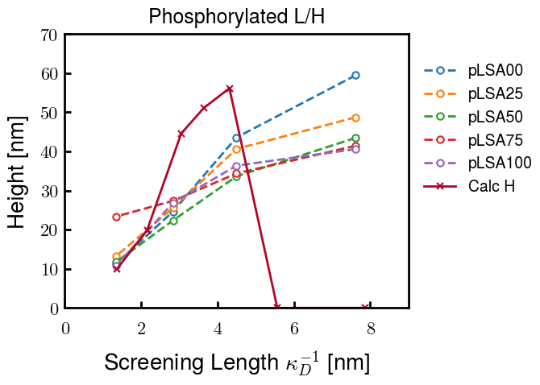
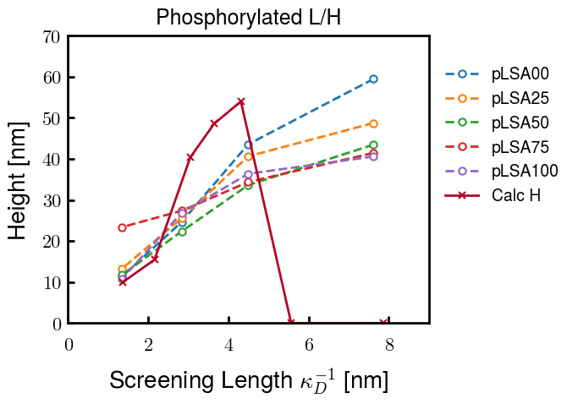
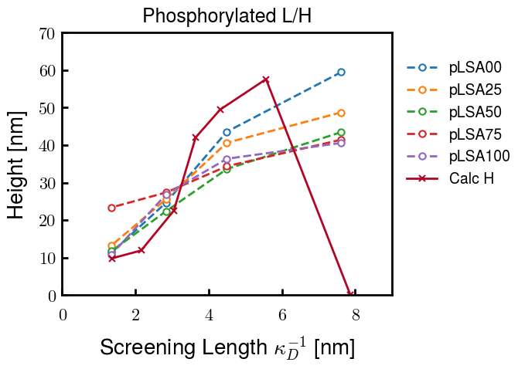
Instead of fitting b/v, could just change value of charge on phos. Try both and see if makes difference for mixture

Slide 25









b2.0 v2.7 c3.2
b3.0 v3.5 c3.5
b3.0 v7.0 c3.5
b3.0 v7.0 c3.0
Phi too small
Phi too small to decrease v0
b4.0 v12.0 c3.0
b5.0 v20.0 c3.0
b5.0 v20.0 c4.0
b5.0 v5.0 c3.0
b5.0 v10.0 c3.0
Phi too small to decrease v0

Slide 26





v20
b5.0 v20.0 c3.0
b4.5 v20.0 c3.0
b4.0 v20.0 c3.0
b3.5 v20.0 c3.0
v10
b5.0 v10.0 c3.0
b4.0 v10.0 c3.0
b3.0 v10.0 c3.0
b2.0 v10.0 c3.0

Slide 27




b2.00 v2.70 c3.20
b2.00 v2.75 c3.20

Slide 28
NFH fitting (from NFL best fit)

Slide 29








b1.00, v0.50, c3.2
b2.00, v4.00, c3.2, th2.5e-02
b1.00, v2.00, c3.2
b1.00, v1.00, c3.2

Slide 30
Mixture

Slide 31



Slide 32


b = 0.75

Slide 33





Slide 34
b = 1.0

Slide 35





Slide 36
b = 1.25

Slide 37




Chi 2.6
Bad vol frac

Slide 38








b25v0
b25v1
b25v2
b25v3

Slide 39




Chi 2.8
Bad vol frac

Slide 40





Slide 41
b = 1.50

Slide 42






Chi 2.8
Bad vol frac

Slide 43





Slide 44

b = 2.00
v4 = 0.25*b^3

Slide 45


Bad vol frac

Slide 46



Slide 47
Fine tune

Slide 48



b1.25, v1.95, c3.0
b1.50, v3.38, c3.0
b2.00, v4.00, c3.0
Norm seems to capture kinked behavior

Slide 49




Slide 50



b1.25, v1.95, c3.2
b1.50, v3.38, c3.2
b2.00, v4.00, c3.2

Slide 51




Slide 52


b1.25
b1.50
b2.00
c2.8
c3.0
c3.2

